Slide 1

INTRODUKSJON TIL C# SOURCE GENERATORS
BouvetOne 20.10.2022
Let's generate all the source!
Nicolas Fløysvik

Slide 3
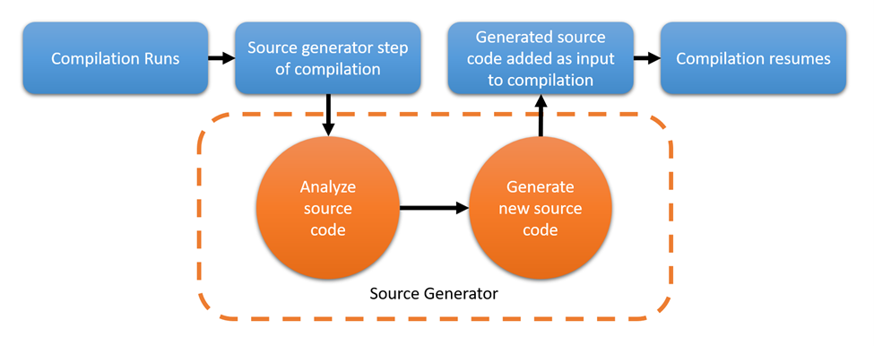
WHAT IS SOURCE GENERATORS
Compilation Runs
Source generator step of compilation
Generated source code added as input to compilation
Compilation resumes
Analyze source code
Generate new source code
Source Generator

Slide 4
BUT WHAT IS A SOURCE GENERATOR
.NET standard 2.0 library
Generates code by analyzing C# and additional files
Extends user code by generating partial classes and methods
Runs live while you code
Installed by using a nuget package

Slide 5
ANATOMY OF A SOURCE GENERATOR
[Generator]
public class HelloSourceGenerator : ISourceGenerator
{
public void Initialize(GeneratorInitializationContext context)
{
// Initialize code here
}
public void Execute(GeneratorExecutionContext context)
{
// Generating extra code here
}
}

Slide 6
DEMO

Slide 7
IF ALL ELSE FAILS OR WANT TO KNOW MORE
https://github.com/nicro950/SourceGeneratorsPresentation
https://learn.microsoft.com/en-us/dotnet/csharp/roslyn-sdk/source-generators-overview

